Slide 1
Continuous Probability Distributions

Slide 2
Overview
Uniform Probability Distribution
Triangular Probability Distribution
Normal Probability Distribution
Exponential Probability Distribution

Slide 3
Discrete Random Variables
Experiment | Random Variable (x) | Possible Values
Contact five customers
Number of customers who place an order
0, 1, 2, 3, 4, 5
Operate a restaurant for one day
Number of customers
0, 1, 2, 3, …
Selling a car
Gender of the customer
0 if male; 1 if female

Slide 4



Continuous Random Variables
Experiment | Random Variable (x) | Possible Values
Operate a bank
Time between customer arrivals in minute
$$x≥0$$
Fill a soft drink can
Number of ounces
$$0≤x≤12.1$$
Construct a new library
Percentage of project completed
$$0≤x≤100$$

Slide 5
Continuous
For a discrete random variable, the probability function f(x) provides the probability that the random variable assumes a particular value.
With continuous random variables, the counterpart of the probability function is the probability density function, also denoted by f(x).
The probability density function does not directly provide probabilities!

Slide 6
Uniform Distribution

Slide 7
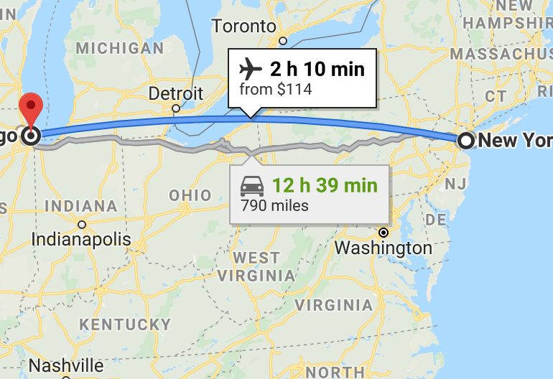
Uniform
Consider the random variable x representing the flight time of an airplane traveling from Chicago to New York. Suppose the flight time can be any value in the interval from 120 minutes to 140 minutes.
Assumption:
The probability of a flight time within any 1-minute interval is the same as the probability of a flight time within any other 1-minute interval contained in the larger interval from 120 to 140 minutes

Slide 8
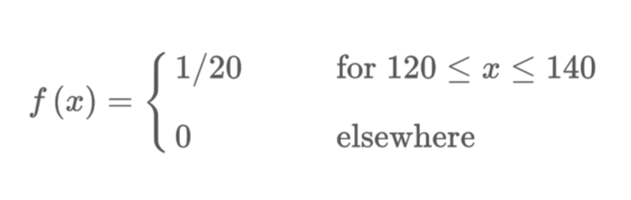

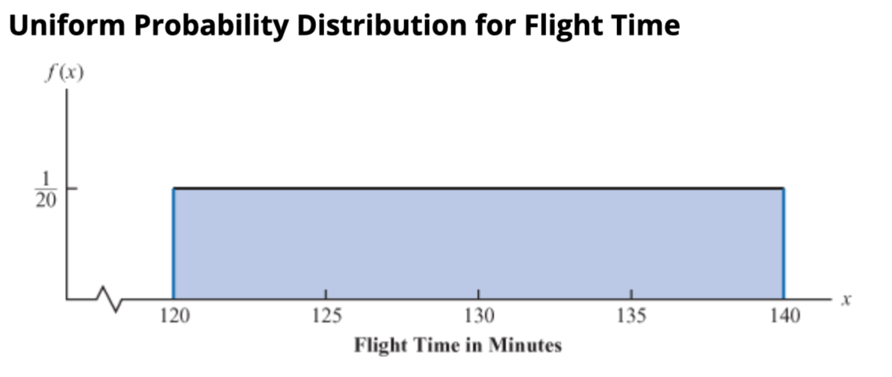
Uniform

Slide 9
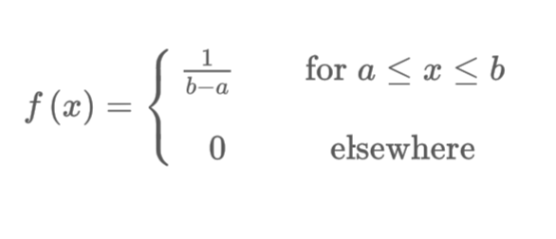
Uniform
Probabilities are defined for intervals. The probability of the R.V. assuming a particular value is zero.
Probabilities are calculated as areas under the P.D.F. curve (Integral).

Slide 10



Continuous
$$E\left(x\right)=\int{f\left(x\right)xdx}$$
Expected Value and Variance:
In R use the dunif, punif, qunif and runif functions.
$$E\left(x\right)=\frac{a+b}{2}$$
$$Var\left(x\right)=\frac{{(b−a)}^{2}}{12}$$

Slide 11
Triangular Distribution

Slide 12
Triangular
The triangular distribution is a subjective description of a population for which there is only limited sample data
It is based on a knowledge of the minimum and maximum and an "inspired guess" as to the modal value.
For these reasons, the triangle distribution has been called a "lack of knowledge" distribution.”
Very useful in simulation and when the most likely outcome is known.

Slide 13
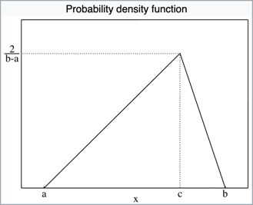



Triangular
$$f\left(x\right)\left\{\begin{aligned}0 for x<a \\ \frac{2(x−a)}{(b−a)(c−a)} for a≤x<c, \\ \frac{2}{b−a} for x=c, \\ \frac{2(b−x)}{\left(b−a\right)(b−c)} for c<x≤b, \\ 0 for b<x\end{aligned}\right.$$
In R use the ptriangle(), qtriangle(), dtriangle(), rtriangle() functions from triangle package.
$$E\left(x\right)=\frac{a+b+c}{3}$$
$$var\left(x\right)=\frac{a^{2}+b^{2}+c^{2}−ab−ac−bc}{18}$$

Slide 14
Normal Distribution

Slide 15
Normal
The normal distribution has been used in a wide variety of practical applications in which the random variables are heights and weights of people, test scores, scientific measurements, amounts of rainfall, and other similar values.
It is also widely used in statistical inference -> Central Limit Theorem

Slide 16
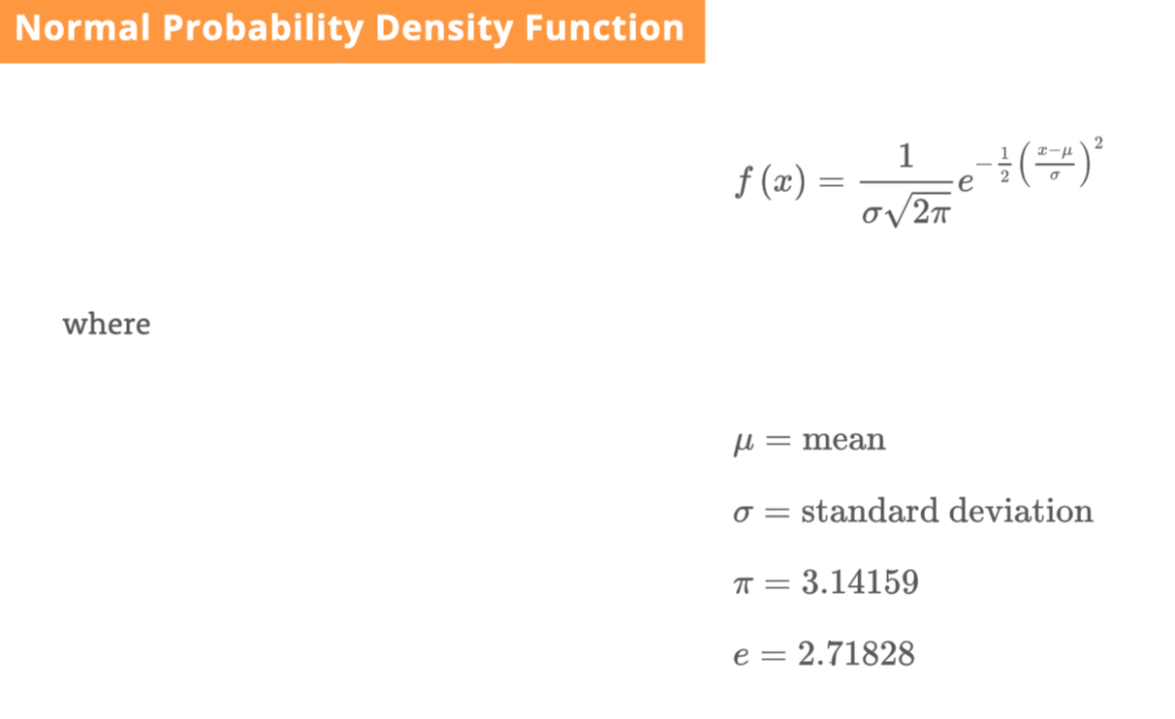
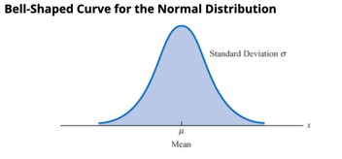
Normal

Slide 17
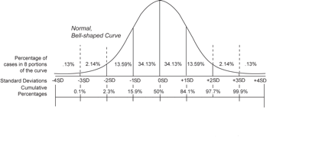
Normal
The normal curve is symmetrical about the mean μ;
The mean is at the middle and divides the area into halves;
The total area under the curve is equal to 1;
It is completely determined by its mean and standard deviation σ (or variance σ²)
Use rnorm(), qnorm(), pnorm() in R.

Slide 18
Exponential Distribution

Slide 19
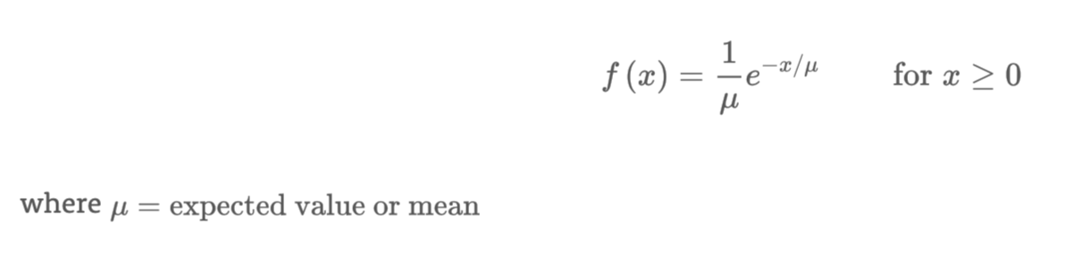
Exponential
The exponential distribution is useful in computing probabilities for the time it takes to complete a task.
Ex: Time between arrivals at a car wash, the time required to load a truck, the distance between major defects in a highway, etc. We will use it in queueing theory and application.

Slide 20

Exponential
Ex: Arrivals at a car wash.
Exponential-> $μ=minutes/1 car$;
Poisson-> $μ=cars/1 minute$;
In R use dexp, rexp, pexp and qexp.

Slide 21
Let’s Practice in R

Slide 22
Problem 1
Before finalizing the tire mileage guarantee policy, Grear’s managers want probability information about x=number of miles the tires will last.
From actual road tests with the tires, Grear’s engineering group estimated that the mean tire mileage is 36,500 and that the standard deviation is 5,000.
What percentage of the tires can be expected to last more than 40,000 miles?
What should a guarante mileage be if Grear wants no more than 10% of the tires to be eligible?

Slide 23
Problem 2
A burger franchise planning a new outlet in Williamsburg estimates that the minimum weekly sales is $1000 and the maximum is $6000. They also estimate that the most likely outcome is around $3000.
What is the probability that future weekly sales are between $2000 and $2500?
What is the probability that future weekly sales are greater than $4000?

Slide 24
Problem 3
Suppose that x represents the loading time for a truck at the Schips loading dock. If the average loading time is 15 minutes,
What is the probability that loading a truck will take 6 minutes or less?
What is the probability that the loading time will be between 6 minutes and 18 minutes?
Can you generate a histogram of loading times?

